Slide 1

A Story of Courage and Advocacy
Malala Yousafzai

Slide 2

Team Members

Slide 3
Early Life and Education
Childhood in Pakistan
Malala Yousafzai was born on July 12, 1997, in Mingora, Pakistan. She grew up in the Swat Valley, where her father, Ziauddin Yousafzai, ran a school for girls. Malala was inspired by her father's activism and advocacy for education, and she began speaking out for girls' education at a young age.
Education and Activism
Malala attended her father's school and became an advocate for education and women's rights. She began blogging for the BBC about her experiences under Taliban rule, and her activism gained international attention. In 2011, she was awarded Pakistan's National Youth Peace Prize for her work promoting peace and education.

Slide 4
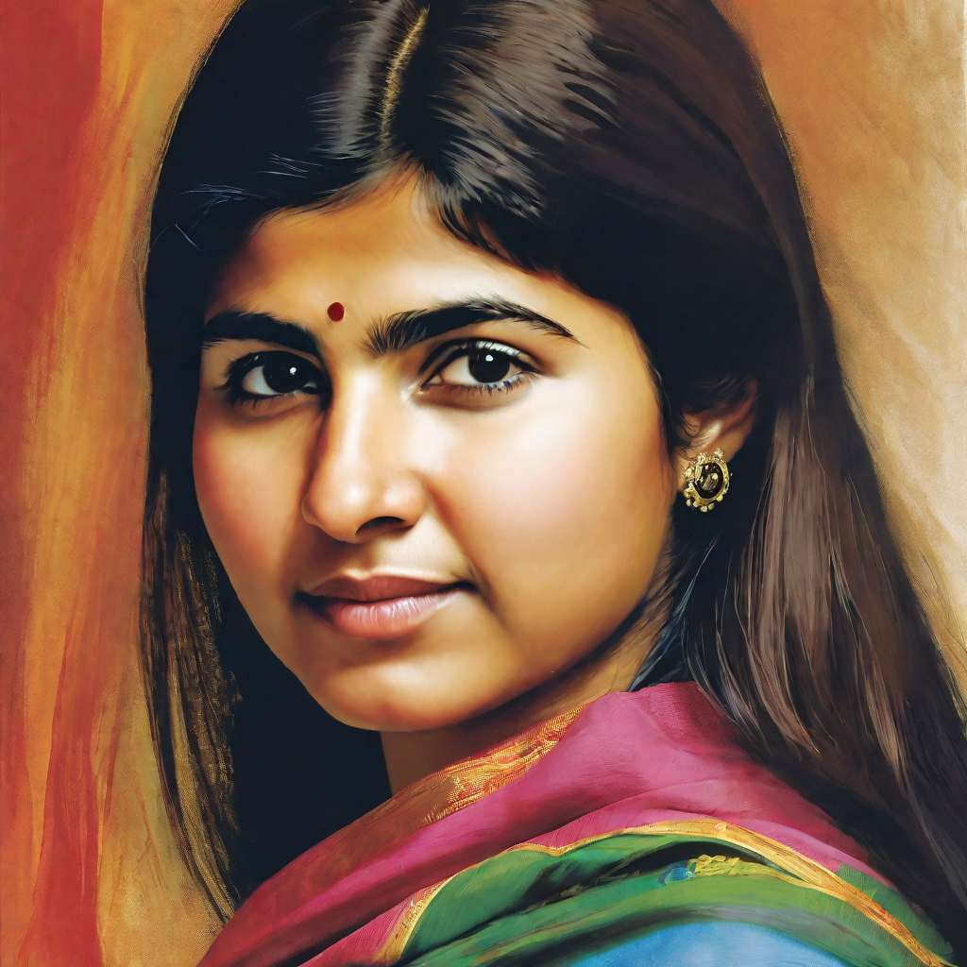
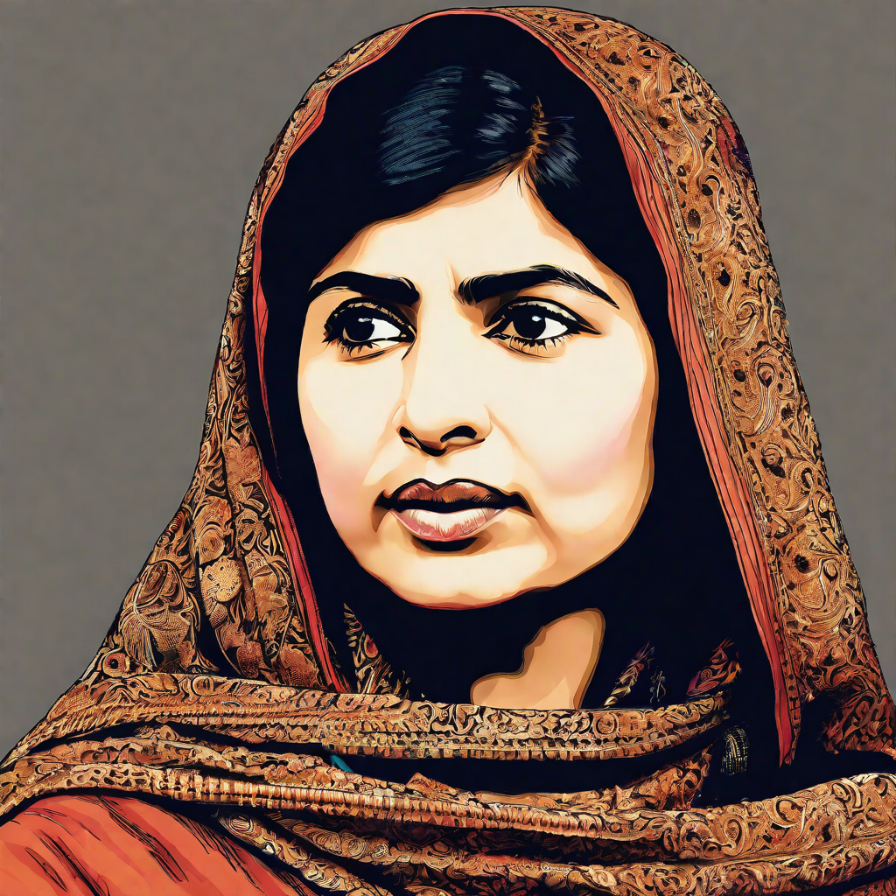
Taliban Takeover and Malala’s Activism
Taliban Takeover
In 2007, the Taliban began to take control of the Swat Valley in Pakistan, where Malala and her family lived. The Taliban imposed strict rules on the population, including banning girls from attending school. Malala became an advocate for girls' education and spoke out against the Taliban's actions.
Malala’s Activism
Malala began speaking out publicly about the importance of education for girls and the need to resist the Taliban's efforts to suppress it. She gave interviews to the media, wrote a blog for the BBC, and even appeared in a documentary about her life. Her activism brought her to the attention of the Taliban, who saw her as a threat.

Slide 5
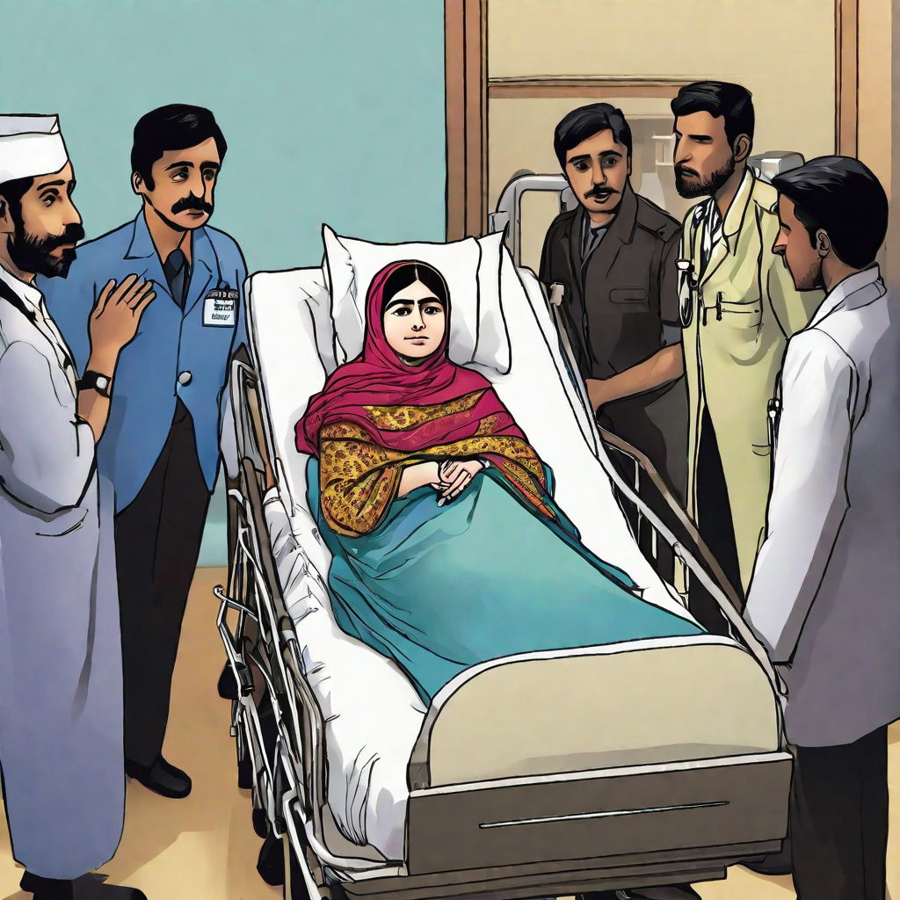
Assassination Attempt and Recovery
Assassination Attempt
In October 2012, Malala was shot in the head by a Taliban gunman while returning home from school in Pakistan.
Recovery
Malala was flown to the United Kingdom for medical treatment and underwent multiple surgeries and rehabilitation.
She received support from people around the world, including celebrities and political leaders.
Malala continued her activism while recovering, using her platform to advocate for education and women's rights.

Slide 6
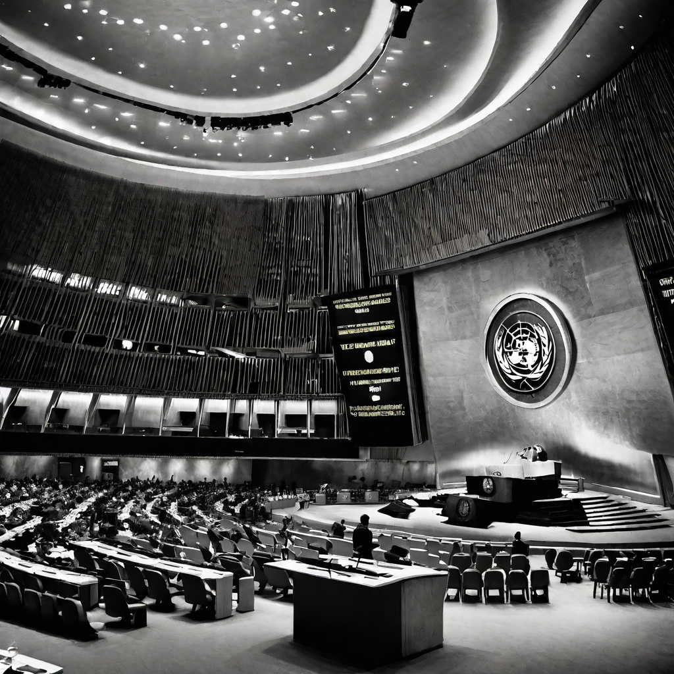
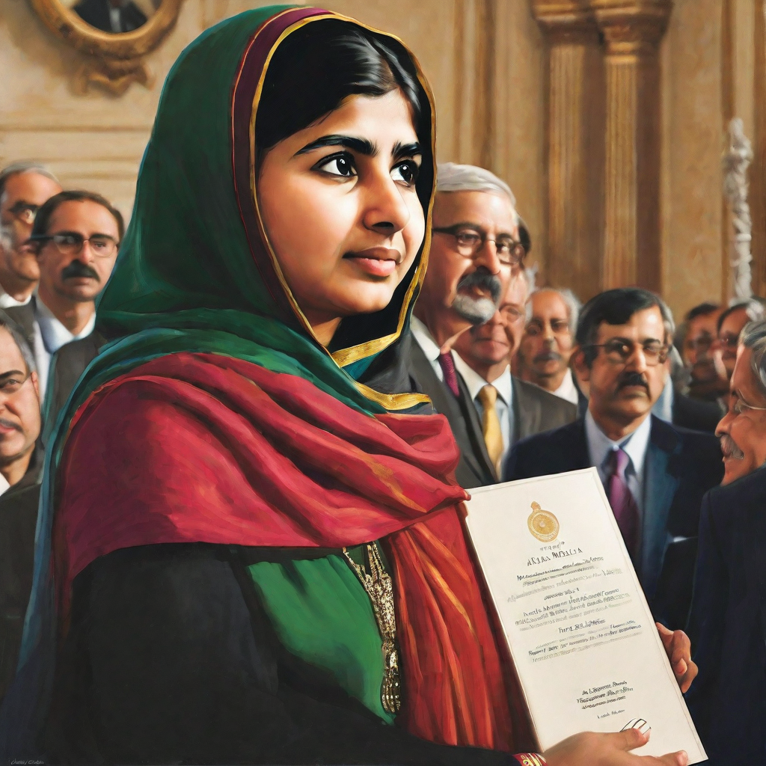
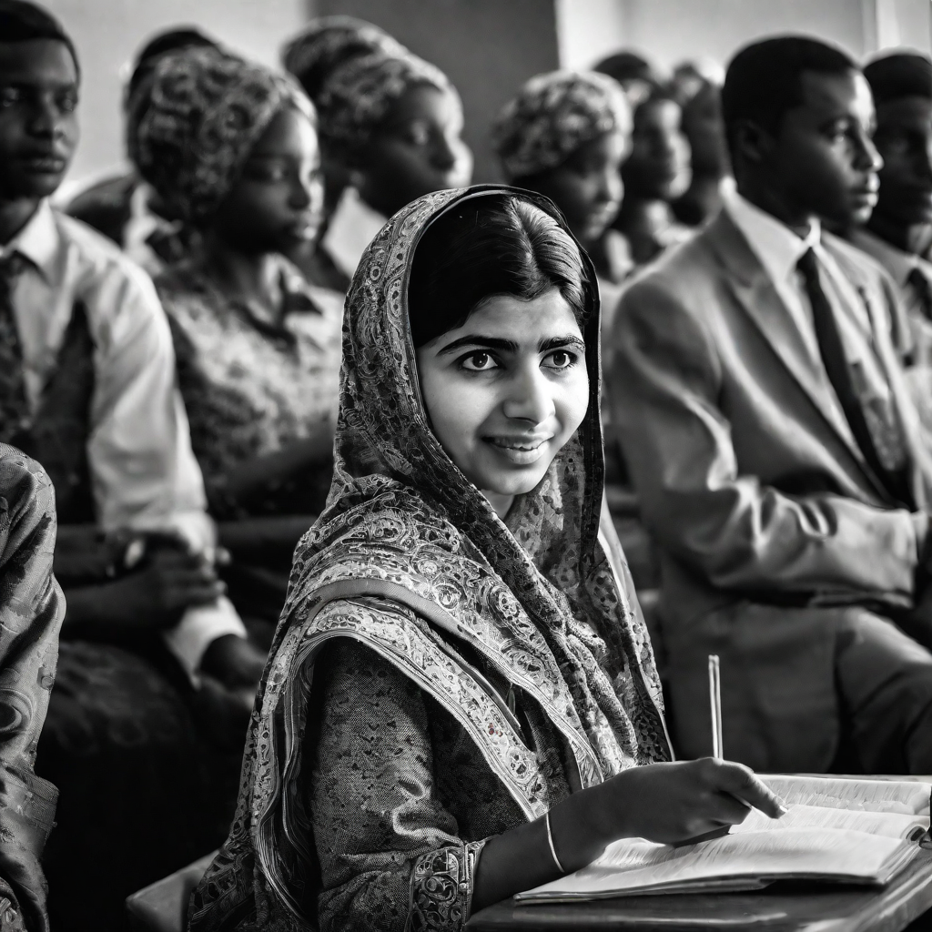
Continued Activism and Achievements
Malala Fund
In 2013, Malala and her father co-founded the Malala Fund, a non-profit organization that works to ensure every girl has access to 12 years of free, safe, and quality education in countries such as Pakistan, Nigeria, and Afghanistan.
Nobel Peace Prize
In 2014, Malala became the youngest-ever Nobel Peace Prize laureate at the age of 17. She was recognized for her struggle against the suppression of children and young people and for the right of all children to education.
Honorary Canadian Citizenship
In 2017, Malala was granted honorary Canadian citizenship. She became the youngest person ever to receive this honor. The Canadian government recognized her dedication to the promotion of girls' education despite facing adversity, particularly the attack on her by the Taliban in 2012.

Slide 7
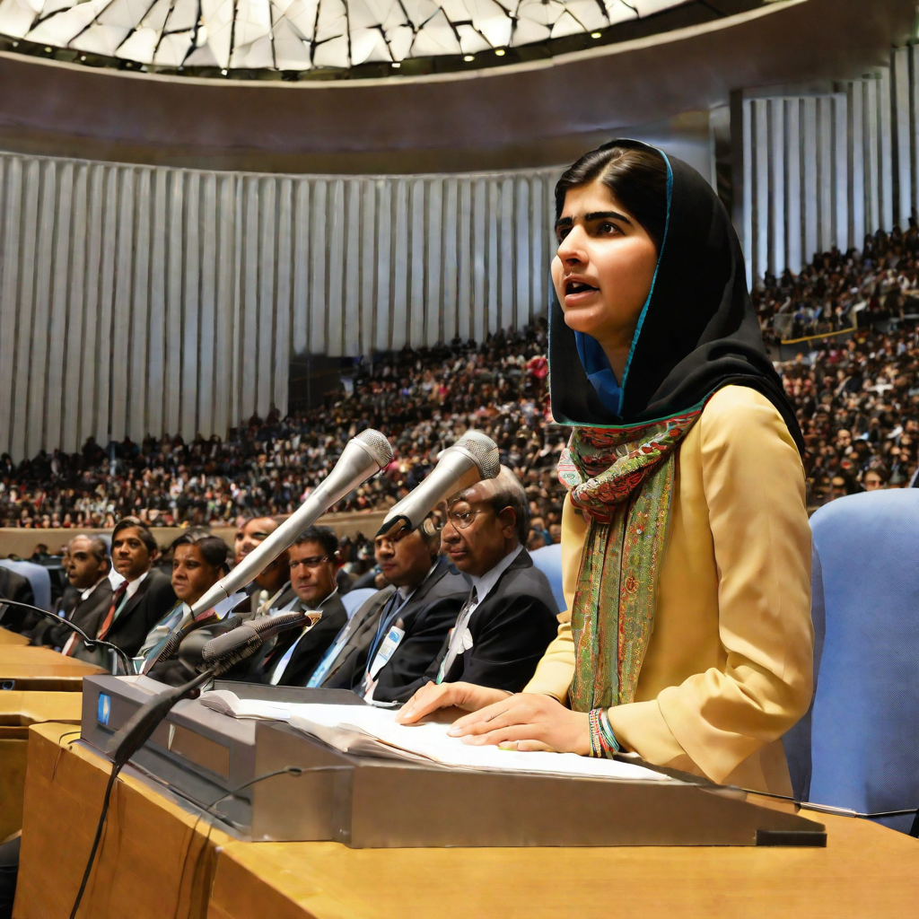
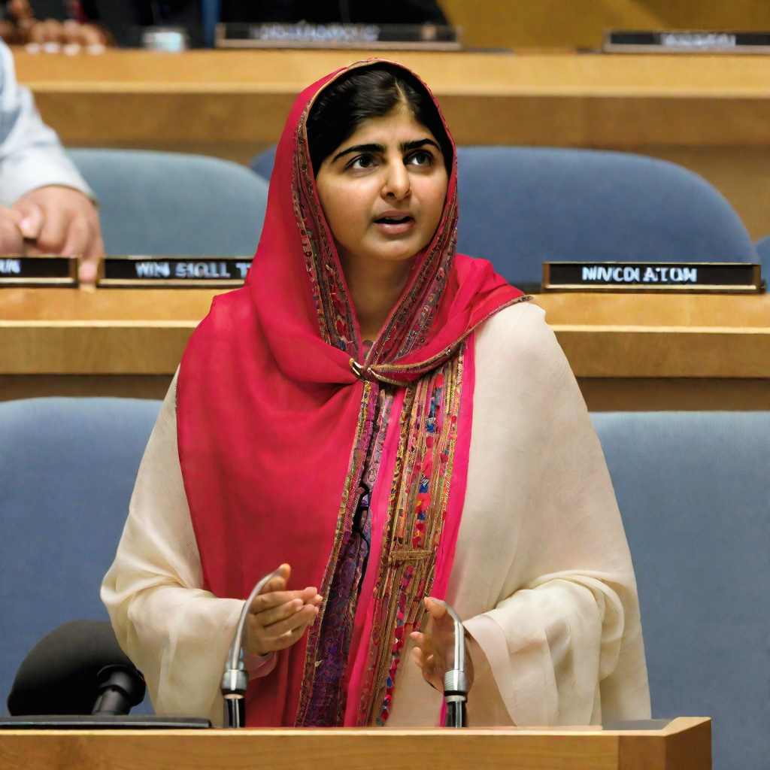
Global Impact and Recognition
Nobel Peace Prize
In 2014, Malala Yousafzai became the youngest ever recipient of the Nobel Peace Prize for her advocacy of education and women's rights.
UN Messenger of Peace
In 2017, Malala was appointed as a UN Messenger of Peace, the highest honor given by the United Nations for work in promoting peace and human rights.

